Slide 1
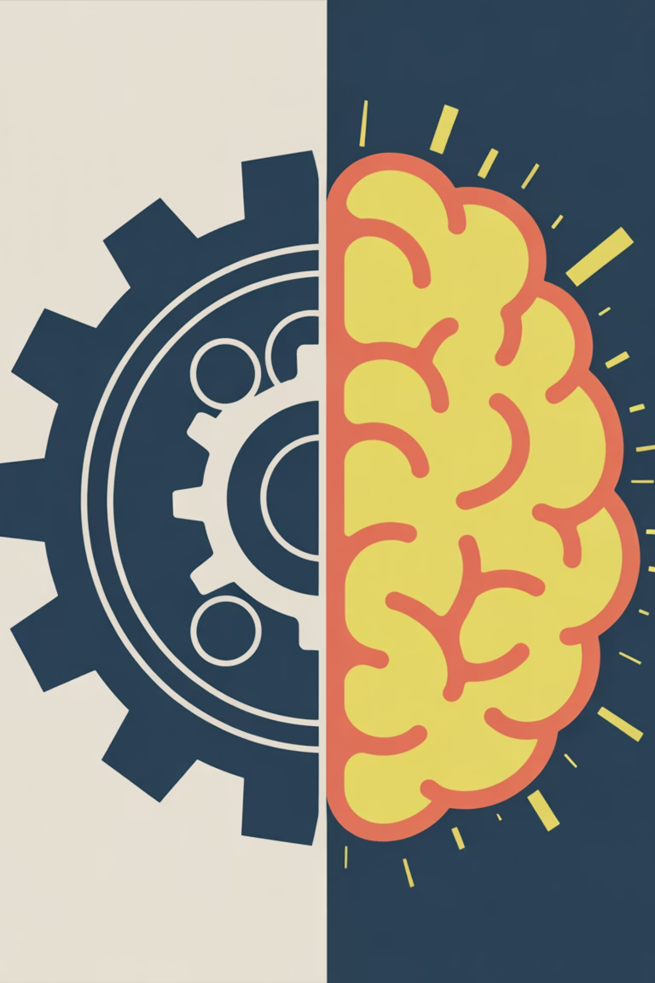
Beyond the Script: Understanding Automation vs. AI Agents
From rigid rules to reasoning machines

Slide 2
The Confusion: They All Look Like "Automation"
When we see a computer doing a human's job, it all looks the same on the surface. An email gets sent automatically. A form gets filled out automatically. A customer query gets answered automatically.
If the output is the same, why does the technology matter?
The Key Insight
It's not about what they do, it's about how they know what to do.
Automation/RPA: The Train
AI Agent: The Off-Road Vehicle
A train on a track. It moves fast and efficiently, but it can only go where the rails are laid. If a tree falls on the track, it stops.
An off-road vehicle with a GPS and a driver. It knows the destination, but it chooses its own path and can steer around obstacles.

Slide 3

Yesterday's Tech: Workflows & RPA
The Rule-Followers
These technologies are amazing at efficiency, but they have zero "intelligence." They are purely reactive.
1
2
Traditional Automation Workflow
Robotic Process Automation (RPA)
The "If/Then" Machine
The "Mimic"
What it is: Hardcoded logic built into software by developers.
What it is: Software "bots" taught to mimic human clicks and typing on a screen.
How it works: "IF event A happens, THEN do action B." There is no deviation.
How it works: It doesn't understand what it's doing; it just knows "Click pixel located at X,Y coordinate, then paste data."
Example: Your calendar automatically sending a Zoom link when you book a meeting.
The Weakness: They are "brittle." If the website changes its button color or location, the RPA bot crashes.
Summary: They follow a script perfectly. They cannot improvise.

Slide 4


Today's Revolution: The AI Agent
The Goal-Achievers
An agent is not defined by a rigid script, but by a high-level goal. It uses an LLM (Large Language Model) as its "brain" to reason through a problem.
Goal-Oriented
Reasoning & Planning
You tell it the "What" (e.g., "Research competitors"), not the "How."
It breaks a big goal down into smaller steps automatically.
Tool Use
Adaptability
It has "arms." It can decide on its own to write code, browse the web, search a database, or send an email to achieve its goal.
The biggest difference: If step 1 fails, it doesn't just crash. It "thinks" of an alternative route to achieve the goal.

Slide 5
The Paradigm Shift
Instructions vs. Intent
The shift from RPA to Agents is a fundamental shift in how humans interact with machines. We're moving from telling computers how to do things to telling them what we want accomplished.
Feature
Traditional Automation / RPA
AI Agent
Input
Precise Instructions ("Click button A")
High-level Intent ("Help this customer")
The "Brain"
A fixed flowchart created by a human
An LLM that can reason in real-time
Handling Errors
Crashes and sends an error alert
Self-corrects, retries, or tries a new approach
Flexibility
Rigid (Like a train on tracks)
Adaptive (Like a self-driving car)

Slide 6
Real World Example: The Invoice Problem
Scenario
A company receives an invoice via email that needs to be read, validated against a Purchase Order (PO) in database A, and paid in accounting software B.
The RPA Approach (The Script)
The AI Agent Approach (The Reasoning)
The Bot logs into email
The Agent is given the goal: "Process incoming invoices"
Looks for attachment named "invoice.pdf"
It reads the email and "sees" an attachment
Opens PDF, scrapes text from exact location X,Y for the "Total Amount"
It uses its "brain" (LLM) to read the PDF, regardless of layout, and identifies the total amount and vendor name based on context
Logs into Database A, pastes amount, clicks "match"
It decides it needs to check the PO database and uses a "database tool" to search
If match confirms, logs into Software B and clicks "Pay"
It compares the data. If it matches, it uses its "payment tool"
FAILURE POINT: The vendor changed their invoice template, moving the "Total Amount" box one inch to the left. The RPA bot fails.
ADAPTATION: If the vendor changed the layout, the agent still understands it's an invoice and finds the total. If the PO doesn't match perfectly, the Agent might draft an email back to the vendor asking for clarification before paying.

Slide 7
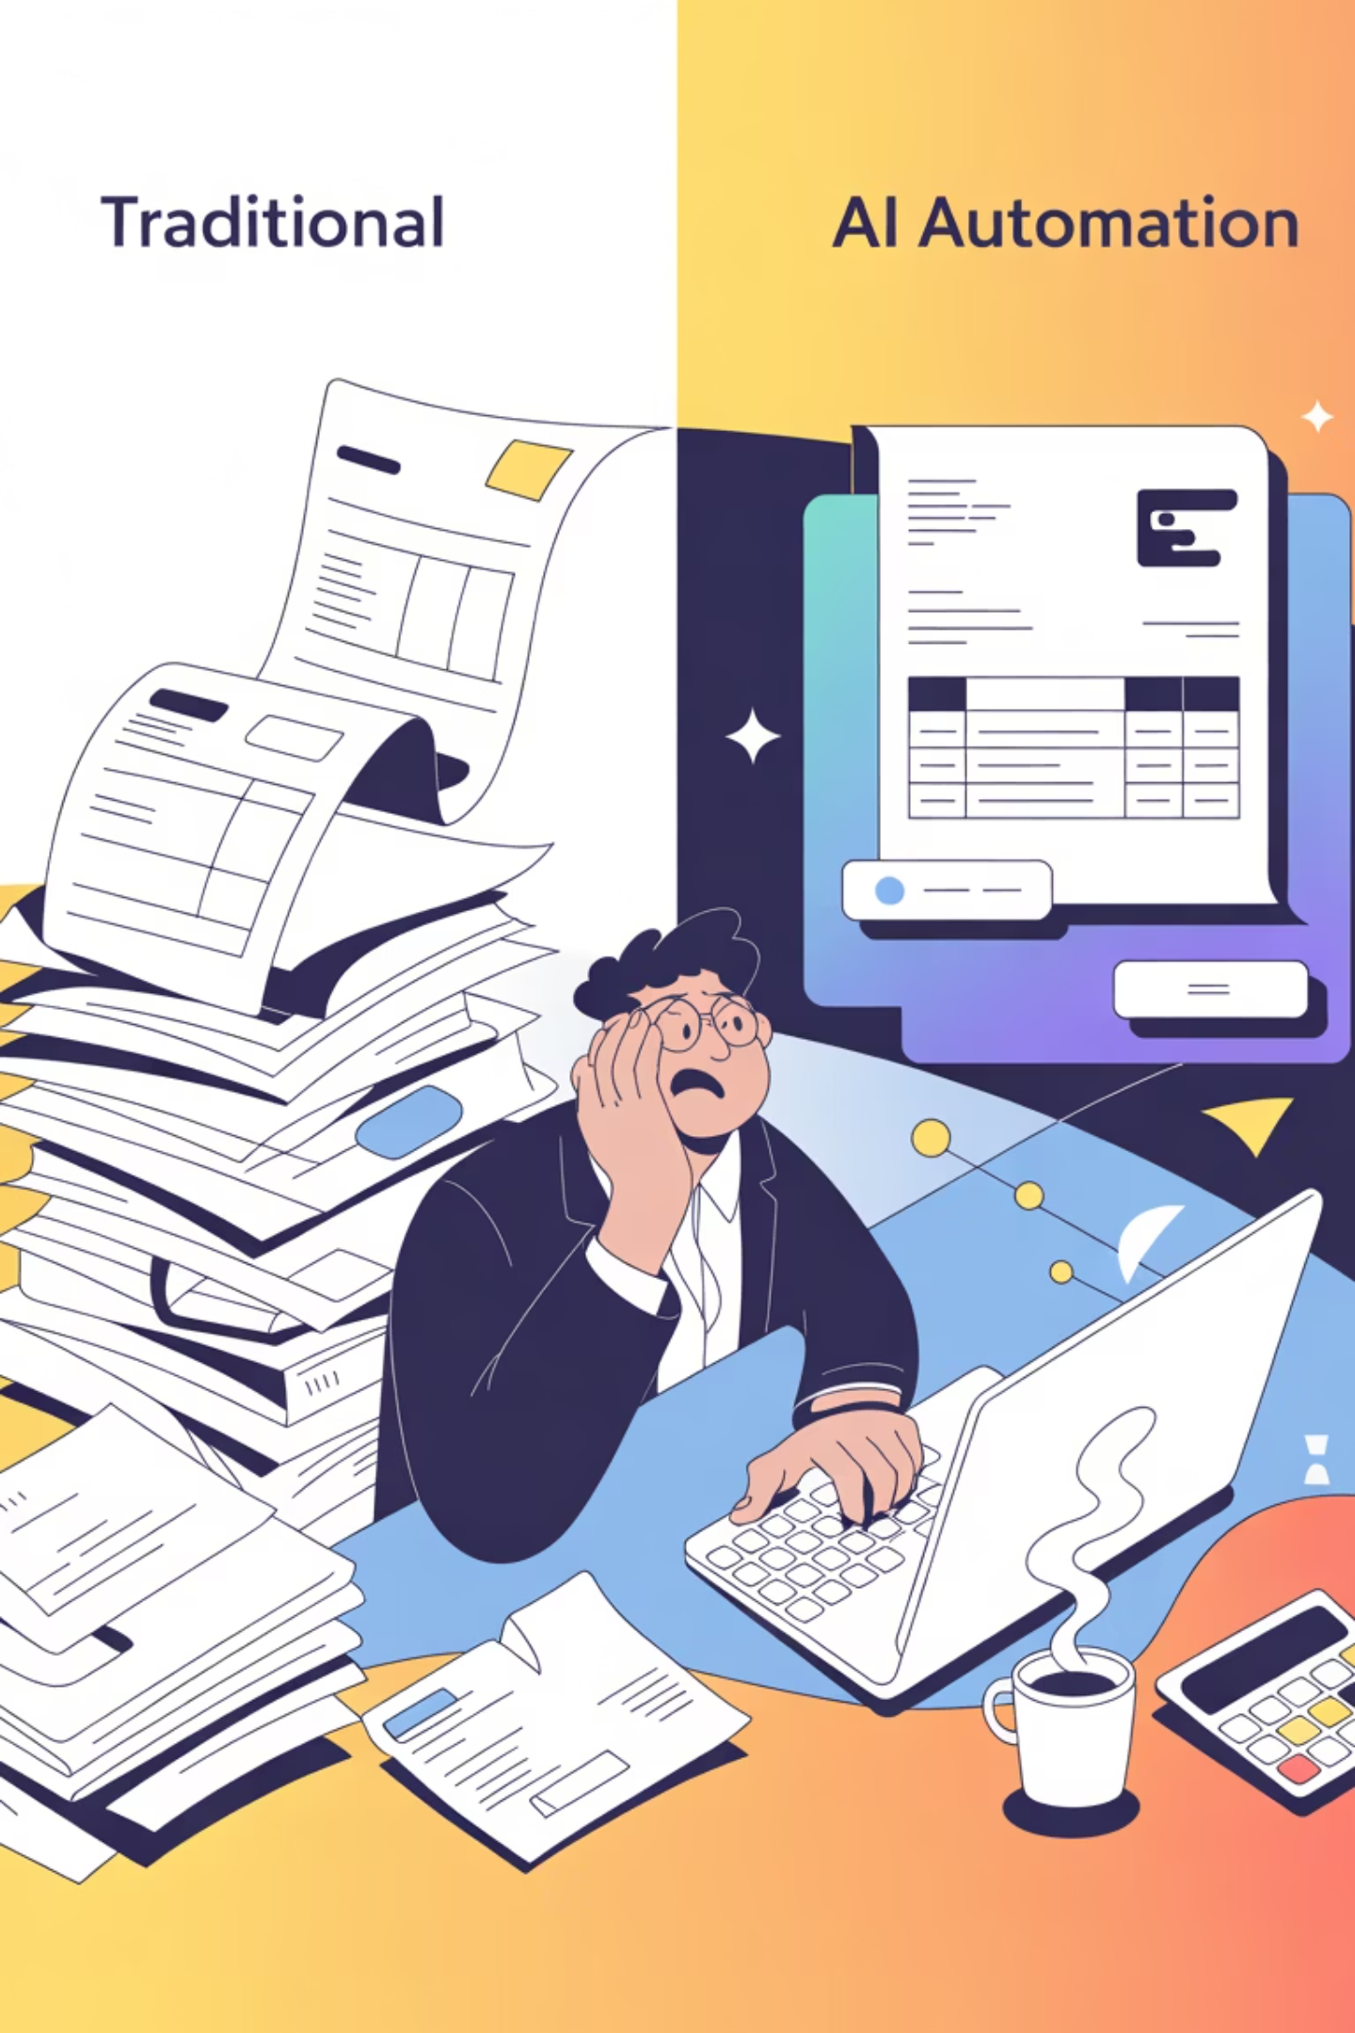
The Invoice Example in Action
This concrete example illustrates the fundamental difference between scripted automation and intelligent agents. The RPA approach is faster when everything goes according to plan, but it's fragile and requires human intervention when anything changes. The AI agent approach is more resilient, adapting to variations and making contextual decisions that would otherwise require a human in the loop.
This adaptability is what makes AI agents transformative for business processes that involve variability, ambiguity, or frequent changes.

Slide 8



The Takeaway Analogy
Think About Cooking Dinner
Automation/RPA
Following a precise recipe card
"Add 1 teaspoon of salt. Stir 10 times."
If you run out of salt, the process stops. You cannot complete the dish.
AI Agent
Hiring a professional Chef
You say: "Make me something delicious and Italian tonight." (The Goal)
The chef checks the pantry (Perception)
They realize there is no salt, so they decide to use parmesan cheese as a substitute for salinity (Reasoning and Adaptation)
They use various knives, ovens, and pans (Tool Use) to achieve the goal

Slide 9
Key Differences at a Glance
Automation/RPA
AI Agents
Fixed, predetermined paths
Dynamic decision-making
Pixel-perfect instructions required
Goal-oriented instructions
Breaks when environment changes
Adapts to changing conditions
No understanding of context
Understands context and meaning
Requires human intervention for exceptions
Self-corrects and finds alternatives

Slide 10
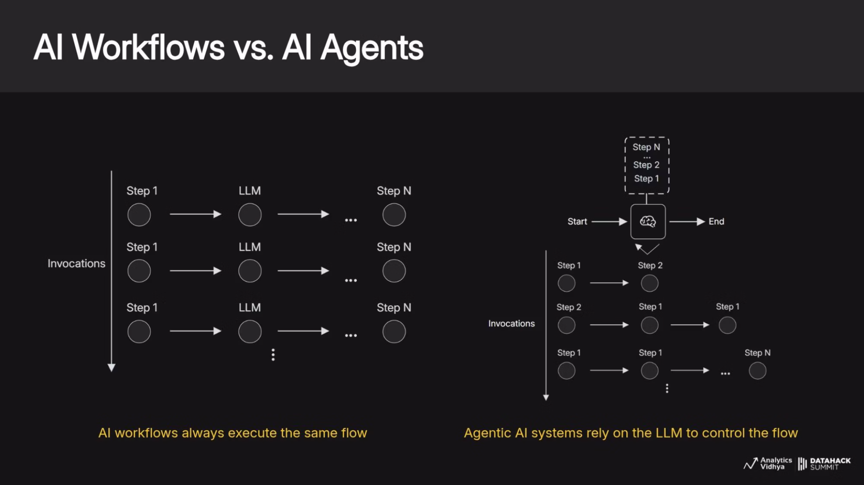

Slide 11
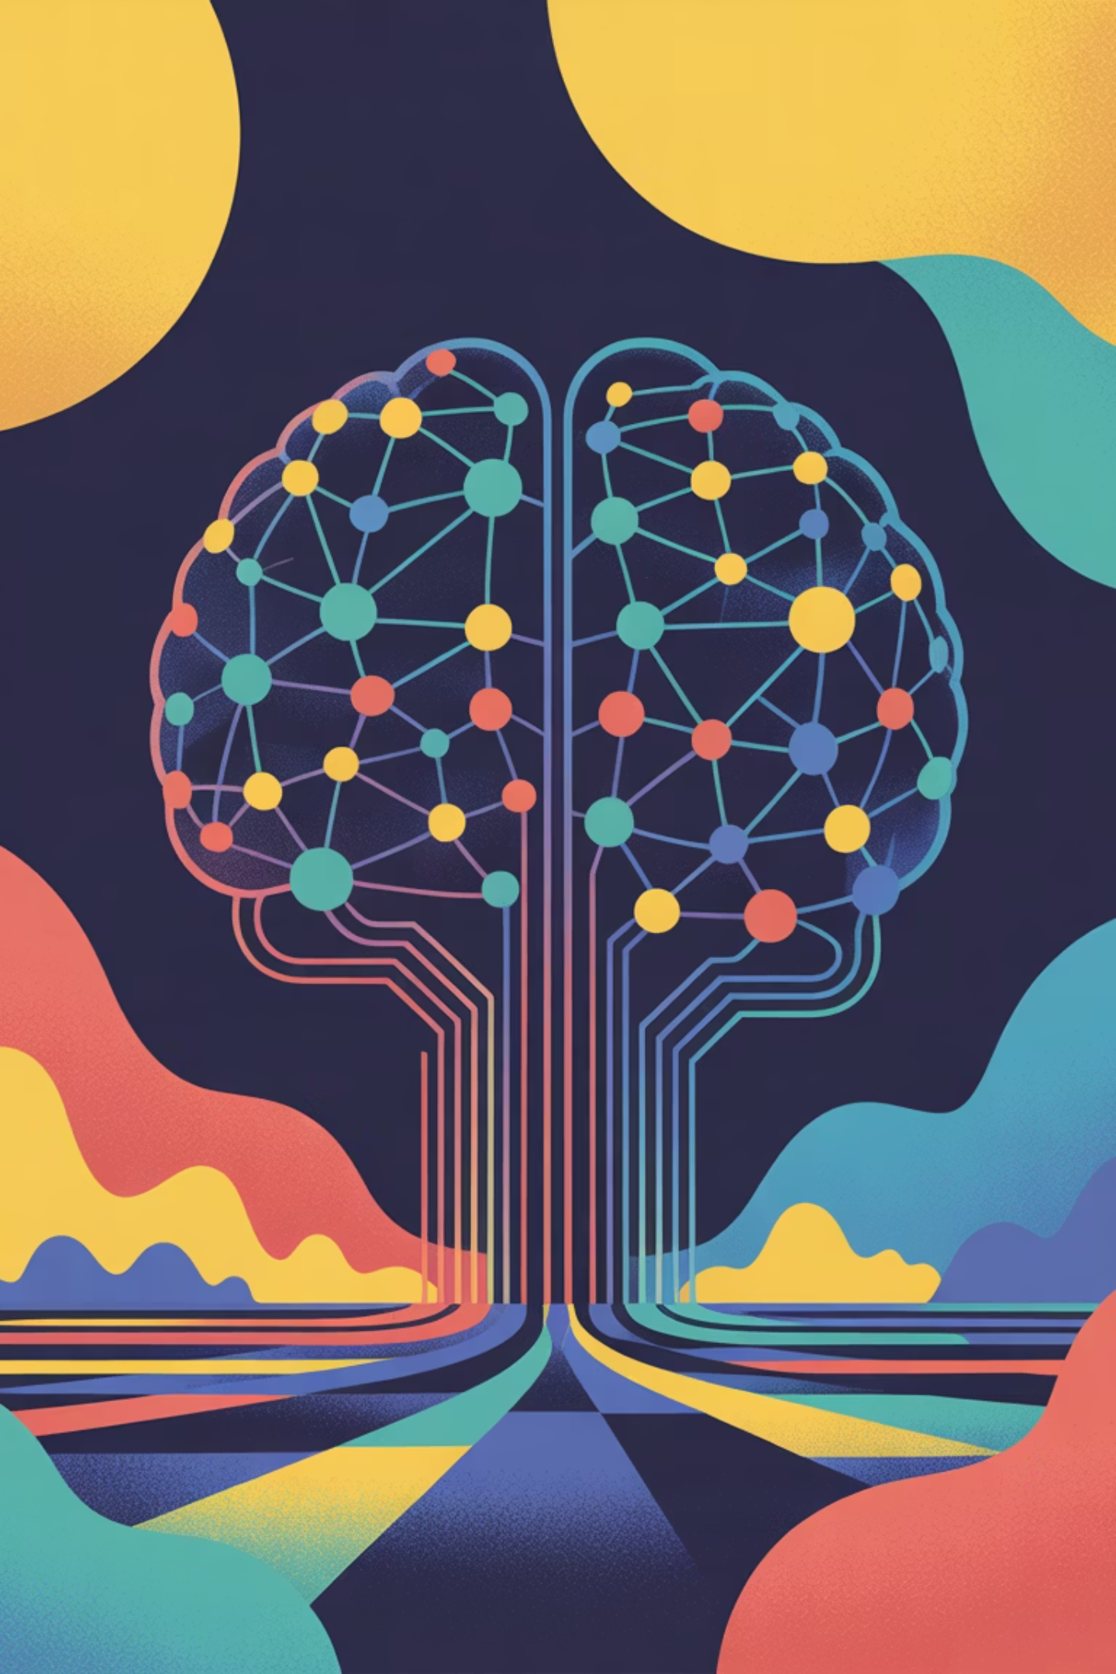
Yesterday we automated tasks.Today we are automating decisions.
This is the fundamental shift that AI agents represent. We're moving from a world where computers follow our exact instructions to a world where they understand our intentions and figure out how to achieve them.
The question is no longer "Can we make this process faster?" but rather "Can we make this process smarter?"
As you continue your journey in technology, remember: the most powerful systems aren't the ones that do exactly what we tell them—they're the ones that achieve what we want, even when the path isn't clear.

